Slide 1
Uchicago Pre-Medical Students Association
First General Meeting: Mon, Oct 7th , BSLC 109
PLEASE SIGN IN!

Slide 2
Our Mission
The University of Chicago Pre-Medical Students Association (PMSA) aims to provide academic, extracurricular, social, and support resources to students interested in pursuing medicine and the health professions.
Cultivate awareness of and foster engagement with issues related to health and medicine in our community
Provide resources to explore health and medicine
Provide support for academic success

Slide 3
Who We Are
President: Stephanie Grach
Vice President: Teresa Chen
Treasurer: Melissa Velasquez
Ast. Treasurer: Luke Versten
Panel Coordinator: Christina Huang
Pritzker Coordinator: Jessie Bronski
Publicist: Anna Tropnikova
Secretary: Sarah Watanaskul
Health Professions Coordinators: Christina Leon and Jacqueline Wang
Volunteer Coordinators: Cindy Avila and Hanna Huang
MCAT Review Rep Coordinator: Elizabeth Doman
UCIHP & Student Activities Liaison: Christian Adames
Webmaster: Andy Rapoport

Slide 4
What We Do (table of contents)
General Meetings! (2/quarter)
Panels (2/quarter)
Study Breaks
Group Volunteering (1-2/quarter)
Health in Context (1/quarter)
Pritzker Luncheon (1/quarter)
Health Professions Conference (spring quarter)
MCAT Prep Discounts

Slide 5
Membership requirements
1 Volunteer Event / Year
1 Panel / Quarter (includes Health in Context)
1 Large Scale Event: Pritzker Luncheon, Health Professions Conference / Year
HIGHLY SUGGESTED: General Meetings, so you can know what to do!
Why are these important?
- Foster community, explore your path appropriately so you understand yourself, and…

Slide 6
we offer discounts.
Kaplan and Princeton Review for MEMBERS ONLY.

Slide 7
Panels
Address broader topics of interest
This quarter: “Stages of Medicine” and “Gap Year”
Possible next quarter: “Cardiology” and “Neurology”
Interested in something else too? Let us know! There’s a poll on the FB group.
We like to hear your voice!

Slide 8
Study Break
A chance to de-stress with free food and socializing!
Why? Because we need a break every now and then!
Will likely combine with future general meetings
twice a quarter, once at the beginning and once at the end of the quarter

Slide 9
Volunteer Events
Previous involvement (independently or through UCSC):
Ronald McDonald House
Global Girls
Community Garden
University of Chicago Medical Center: Center for Care and Discovery Opening/Move-In Day
And more…
We can also get you connected!

Slide 10
Health in Context
Guest faculty member who conducts clinical research in or has extensive knowledge of a particular field
Explore interdisciplinary aspects of health and medicine
New perspectives in controversy
Non-board students can get involved and coordinate if they’d like!

Slide 11
Pritzker Luncheon
Talk with Pritzker students
Casual, but nice!
Free Lunch

Slide 12
Health Professions Conference
10th annual – bigger and better!
Sponsored by UCIHP
Workshops on medical school/grad school
Get-to-know-you-lunch
Fair-styled tabling
SAVE THE DATE: May 2, 2013 [Friday!]

Slide 13
Example Schedule
WK2: General Meeting (this!)
WK3: Panel – Stages of Medicine
WK4: Volunteer Experience
WK5: Pritzker Luncheon
WK6: Volunteer Experience
WK7: Panel – Gap Year Information
WK8: Health in Context
WK9: General Meeting / Study Break
Note: this is an example schedule – you’ll have to stay up-to-date through the listhost and/or our websites!

Slide 14
New Things!

Slide 15
Awesome Website!
pmsa.uchicago.edu
One-stop shop for things PMSA, includes:
UChicago resources
Outside resources
Events calendar
Links
Media: PowerPoints, pics, etc.
Forum (!)
Contact Info + Bios

Slide 16
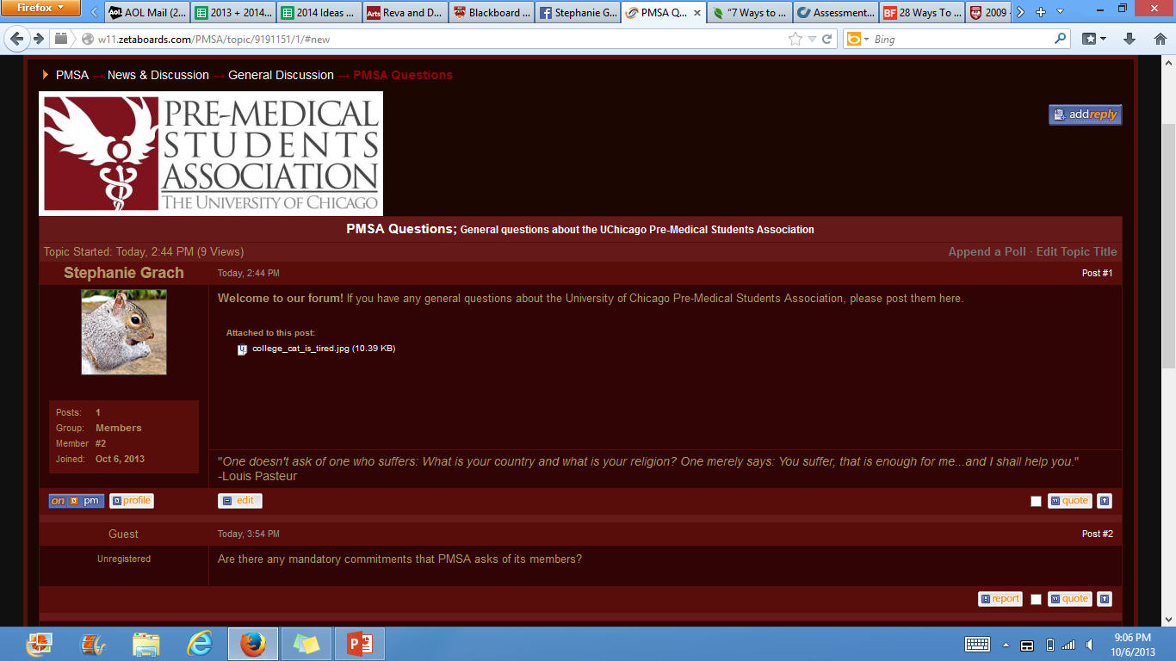

Slide 17
Mentorship Opportunities
PMSA Board
We will send out easy survey link to attendees/listhost for match
Students will get a board member who is their year or older
Your primary PMSA contact
Pritzker Students
In planning stages – you’ll be able to connect with potential mentors at the Pritzker luncheons!
ULTIMATE GOAL: Get you better access to the resources we can provide, including connections to the University of Chicago Medical Center

Slide 18
Pre-Med Professional Fraternity
Phi Delta Epsilon (PhiDE) Medical Fraternity “creates physicians of integrity with a life-long commitment to our guiding principles of philanthropy, deity, and education through fellowship, service, mentoring, and formal training in leadership, science, and ethics.” (mission statement)
Currently in process of applying for RSO status, so not going just quite yet
If successful, active membership requirements will satisfy PMSA requirements
If interested, contact Maxine Frendel at maxinefrendel@uchicago.edu or me (Stephanie Grach – sgrach@uchicago.edu ) with Name, Email, Year

Slide 19
Magazine Drive
Coordinating a round-year magazine drive so that patients at the UC Medical Center can have reading material while hospitalized
Keep an eye out for our beautiful bins!
Will mostly be in dorms, but will try to place in other places
Contact Rajya, rajya.karipineni@uchospitals.edu , for general hospital questions

Slide 20
Our GOALS (for you)
Collaboration
Balance
Academics, activities, opinions…
Choice
Take your own path!
Don’t be ashamed to not be pre-med!
Don’t be ashamed to be pre-med!

Slide 21
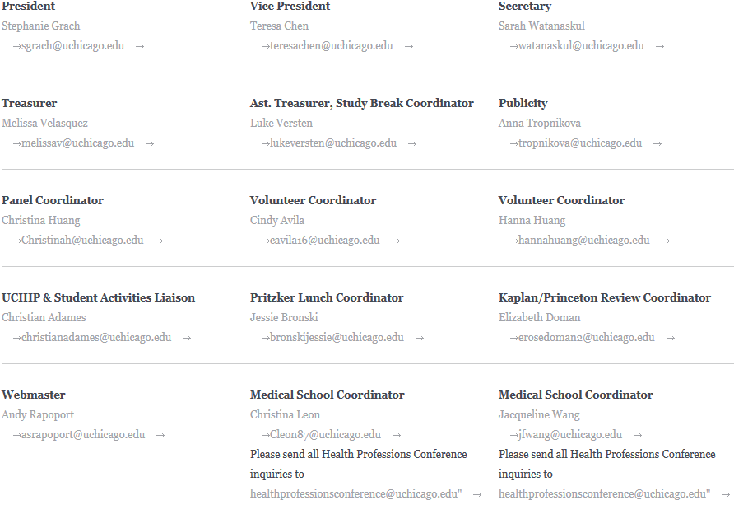
How to Contact/Hear From Us: Website (and forum)!!

Slide 22
And Go to UCIHP!!
UChicago Careers in Health Professions – you have an advisor assigned based on the last # of your ID, so call over/go in and start with them!

Slide 23
Ice Breaker!
Board Members will find an area; divide
Tell your group: name, year, potential major/health interest, any interesting fact
PASS THE MOTION:
Stand in some sort of circle
Choose a unique motion that can be done in 2 beats
Circle starts clapping
Do your motion and say your name at the same time, clap twice, pass by doing motion/saying name of person you’re passing to
CONTINUE
First few rounds are practice – elimination afterwards!
When eliminated, say [another] cool fact about yourself (and stick around for more rounds) ☺

